Slide 1
Chapter 3: Searching/Substitution: regular expression
CISC3130, Spring 2013
Xiaolan Zhang
1

Slide 2
Outline
Shell globbing, or pathname expansion
grep, egrep, fgrep
Regular expression
sed
cut, paste, comp, uniq, sort
2

Slide 3
Globbing, filename expansion
Globbing: shell expands filename patterns or templates containing special characters.
e.g., example.??? might expand to example.001 and example.txt
Demo using echo command: echo *
Globbing is carried out by shell
recognizes and expands wild cards.
* (asterisk): matches every filename in a given directory.
?: match a single-character
[ab]: match a or b
^ : negating the match.
Strings containing * will not match filenames that start with a dot

Slide 4
Examples
$ ls
a.1 b.1 c.1 t2.sh test1.txt
$ ls t?.sh
t2.sh
$ ls [ab]*
a.1 b.1
$ ls [a-c]*
a.1 b.1 c.1
$ ls [^ab]*
c.1 t2.sh test1.txt
$ ls {b*,c*,*est*}
b.1 c.1 test1.txt

Slide 5
Outline
Shell globbing, or pathname expansion
grep, egrep, fgrep
regular expression
sed
cut, paste, comp, uniq, sort
5

Slide 6
Filter programs
Filter: program that takes input, transforms input, produces output.
default: input=stdin, output=stdout
e.g.: grep, sed, awk
Typical use:
$ program pattern_action filenames
program scans files (if no file is specified, scan standard input), looking for lines matching pattern, performing action on matching lines, printing each transformed line.

Slide 7
grep/egrep/fgrep commands
grep comes from ed (Unix text editor) search command “global regular expression print” or g/re/p
so useful that it was written as a standalone utility
two other variants
grep - pattern matching using Basic Regular Expression
fgrep – file (fast, fixed-string) grep, does not use regular expressions, only matches fixed strings but can get search strings from a file
egrep - extended grep, uses an Extended Regular Expression (more powerful, but does not support backreferencing)

Slide 8
grep syntax
Syntax
grep [-hilnv] [-e expression] [filename], or
grep [-hilnv] expression [filename]
Options
-E use extended regular expression (replace egrep)
-F match using fixed string (replace fgrep)
-h do not display filenames
-i Ignore case
-l List only filenames containing matching lines
-n Precede each matching line with its line number
-v Negate matches
-x Match whole line only (fgrep only)
-e expression Specify expression as option
-f filename Take regular expression (egrep) or a list of strings (fgrep) from filename

Slide 9
A quick exercise
How many users in storm has same first name or last name as you ?
In which C++ source file is a certain variable used?
In which file is the variable defined?
We can specify pattern in regular expression
How many users have no password ?
Extract all US telephone numbers listed in a text file?
718-817-4484
718,817,4484,
718,8174484, ….

Slide 10
Outline
Shell globbing, or pathname expansion
grep, egrep, fgrep
Regular expression
Basics: BRE and ERE
Common features of BRE and ERE
BRE backreference
ERE extensions
sed
cut, paste, comp, uniq, sort
10

Slide 11
What Is a Regular Expression?
A regular expression (regex) describes a set of possible input strings, i.e., a pattern
e.g., ls -l | grep ^d ## list only directories
e.g., grep MAX_INT *.h ## where is MAX_INT defined
Regular expressions are endemic to Unix
vi, ed,
grep, egrep, fgrep, sed
emacs, awk, tcl, perl, Python
more, less, page, pg
Libraries for matching regular expressions: GNU C Library, and POSIX.2 interface (link)

Slide 12
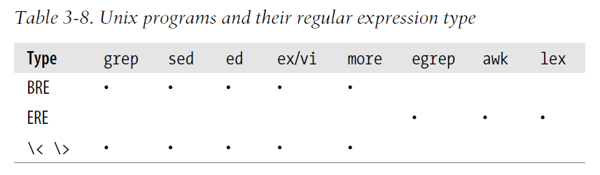
POSIX: BRE and ERE
Basic Regular Expression
Original
Supported by grep
Extended Regular Expression
more powerful, originally supported in egrep

Slide 13
Outline
Shell globbing, or pathname expansion
Grep, egrep, fgrep
Regular expression
Basics: BRE and ERE
Common features of BRE and ERE
BRE backreference
ERE extensions
sed
cut, paste, comp, uniq, sort
13

Slide 14
BRE/ERE common metacharacters
^ (Caret) match expression at start of a line, as in ^d.
$ (Dollar) match expression at end of a line, as in A$.
\ (Back slash) turn off special meaning of next character, as in \^.
[ ] (Brackets) match any one of the enclosed characters, as in [aeiou], use hyphen "-" for a range, as in [0-9].
[^ ] match any one character except those enclosed in [ ], as in [^0-9].
. (Period) match a single character of any value, except end of line.
*(Asterisk) match zero or more of preceding character or expression.

Slide 15
Protect Metacharacters from Shell
Some regex metachars have special meaning for shell: globbing and variable reference
$ grep e* .bash_profile ## suppose there are files email.txt, e_trace.txt
# under current dir
Actual command executed is:
grep email.txt e_trace.txt .bash_profile
$ grep $PATH file ## $PATH will be replaced by value of PATH…
Solution: single quote regexs so shell won’t interpret special characters
grep 'e*' .bash_profile
double quotes differs from single quotes: allows for variable substitution whereas single quotes do not.

Slide 16
Escaping Special Characters
\ (backslash): match special character literally, i.e., escape it
E.g., to match character sequence 'a*b*'
'a*b*' : ## match zero or more ‘a’s followed by zero or more ## ‘b’s, not what we want
'a\*b\*' ## asterisks are treated as regular characters
Hyphen when used as first char in pattern needs to be escaped
ls -l | grep '\-rwxrwxrwx'
# list all regular files that are readable, writable and executable to all
To look for reference to shell variable PATH in a file
grep '\$PATH' file.txt

Slide 17
Regex special char: Period (.)
Period . in regex matches any character.
grep 'o. ' file.txt
How to list files with filename of 5 characters ?
ls | grep ‘..... ' ## actually list files with filename 5 or more chars long? Why?
How to list normal files that are executable by owners?
ls -l | grep '\-..x '
regular expression
o .
For me to poop on.
match 1
match 2

Slide 18
Character Classes
Character classes [] can be used to match any char from the specific set of characters.
[aeiou] will match any of the characters a, e, i, o, or u
[kK]orn will match korn or Korn
Ranges can be specified in character classes
[1-9] is the same as [123456789]
[abcde] is equivalent to [a-e]
You can also combine multiple ranges
[abcde123456789] is equivalent to [a-e1-9]
Note - has a special meaning in a character class but only if it is used within a range, [-123] would match the characters -, 1, 2, or 3

Slide 19
Character Classes (cont’d)
Character classes can be negated with the [^ ] syntax
[^1-9] ##match any non-digits char
[^aeiou] ## match with letters other than a,e,i,o,u
Commonly used character classes can be referred to by name (alpha, lower, upper, alnum, digit, punct, cntrl)
Syntax [:name:]
[a-zA-Z] [[:alpha:]]
[a-zA-Z0-9] [[:alnum:]]
[45a-z] [45[:lower:]]

Slide 20
Anchors
Anchors: match at beginning or end of a line (or both).
^ means beginning of the line
$ means end of the line
To display all directories only
ls -ld | grep ^d ## list all lines start with letter d
To display all lines end with period
grep '\.$' .bash_profile ## lines end with .

Slide 21
Exercise
To display all empty lines
grep '^$' .bash_profile ## empty lines
How to list files with filename of 5 characters ?
ls | grep '^.....$ ' ## Now it’s right
Find all executable files under current directory ?

Slide 22
Repetition
* match zero or more occurrences of character or character class preceding it.
x* ## match with zero or more x
grep 'x*' .bash_profile ## display all lines, as all lines have zero or more x
abc* ## match with ab, abc, abccc, …
.*x ## matches anything up to and include last x in the line
Ex: How to match C/C++ one-line comments, starting from // ? (use sed to remove all comments…)

Slide 23
Interval Expression
Interval expression: specify # of occurrences
BRE:
\{n,m\}: between n and m occurrence of previous exp
\{n\}: exact n occurrence of previous exp
\{n,\}: at least n occurrence of previous exp
ERE:
{n} means exactly n occurrences
{n,} means at least n occurrences
{n,m} means at least n occurrences but no more than m occurrences
Example:
.{0,} same as .*
a{2,} same as aaa*
.{6} same as ……

Slide 24
Outline
Shell globbing, or pathname expansion
Grep, egrep, fgrep
Regular expression
Basics: BRE and ERE
Common features of BRE and ERE
BRE backreference
ERE extensions
sed
cut, paste, comp, uniq, sort
24

Slide 25
BRE: Backreferences
Backreferences: refer to a match made earlier in a regex
E.g., to find lines starting and ending with same words
How:
Use \( and \) to mark a sub-expression that we want to back reference
Use \n to refer to n-th marked subexpression
One regex can have multiple backreferences
Ex: to search for lines that start with two same characters
grep '^\(.\)\1' file.txt

Slide 26
Back-references
Recall /etc/passwd stores info. about user account
[zhang@storm ~]$ head /etc/passwd
root:x:0:0:root:/root:/bin/bash
bin:x:1:1:bin:/bin:/sbin/nologin
To find accounts whose uid is same as groupid
grep '^[^:]*:[^:]*:\([0-9]*\):\1' /etc/passwd
Find five-letter long palindrome in wordlist
grep '\(.\)\(.\).\2\1' wordlist

Slide 27
Outline
Shell globbing, or pathname expansion
Grep, egrep, fgrep
Regular expression
Basics: BRE and ERE
Common features of BRE and ERE
BRE backreference
ERE extensions
sed
cut, paste, comp, uniq, sort
27

Slide 28
ERE: Grouping, Subexpressions
( ) group part of an expression to a sub-expression
Sub-expresssions are treated like a single character
* or { } can be applied to them
Example:
a* matches 0 or more occurrences of a
abc* matches ab, abc, abcc, abccc, …
(abc)* matches abc, abcabc, abcabcabc, …
(abc){2,3} matches abcabc or abcabcabc

Slide 29
ERE: Alternation
Alternation character |: matching one or another sub-expression
(T|Fl)an will match ‘Tan’ or ‘Flan’
^(From|Subject): will match lines starting with From or Subject, followed by a :
Sub-expressions are used to limit scope of alternation
At(ten|nine)tion then matches “Attention” or “Atninetion”
not “Atten” or “ninetion” as would happen without the parenthesis - Atten|ninetion

Slide 30
ERE: Repetition Shorthands
*(asterisk): (BRE and ERE) match zero or more occurrences of preceding char (or expression for ERE)
+ (plus) : one or more of preceding char/expression
abc+d will match ‘abcd’, ‘abccd’, or ‘abccccccd’ but will not match ‘abd’
Equivalent to {1,}
‘?’ (question mark): single character that immediately precedes it is optional
July? will match ‘Jul’ or ‘July’
Equivalent to {0,1}

Slide 31
egrep Examples
Find all lines with signed numbers
$ egrep ’[-+][0-9]+\.?[0-9]*’ *.c bsearch. c: return -1; compile. c: strchr("+1-2*3", t-> op)[1] - ’0’, dst, convert. c: Print integers in a given base 2-16 (default 10) convert. c: sscanf( argv[ i+1], "% d", &base); strcmp. c: return -1; strcmp. c: return +1;

Slide 32
A good help with Crossword
How many words have 3 a’s one letter apart?
egrep a.a.a wordlist| wc –l
54
egrep u.u.u wordlist
Cumulus
Words of 7 letters that start with g, 4th letter is a, and 7th letter is h
egrep ′g..a..h$′ wordlist

Slide 33
Practical Regex Examples
Variable names in C
[a-zA-Z_][a-zA-Z_0-9]*
Dollar amount with optional cents
\$[0-9]+(\.[0-9][0-9])?
Time of day
(1[012]|[1-9]):[0-5][0-9] (am|pm)
HTML headers <h1> <H1> <h2> …
<[hH][1-4]>

Slide 34
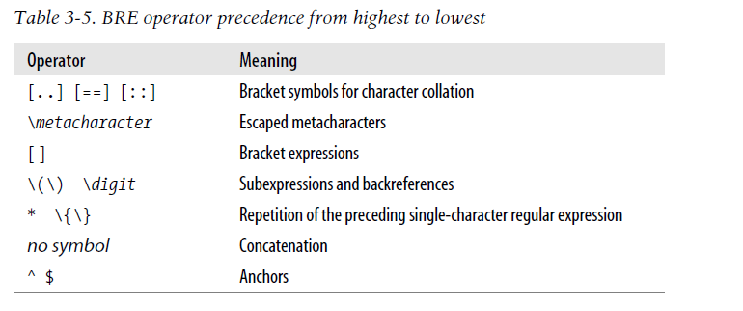

Slide 35
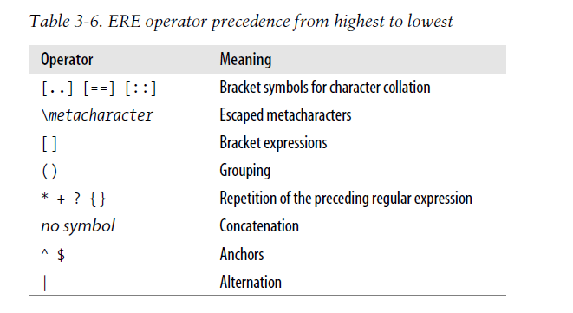

Slide 36
This is one line of text
input line
o.*o
regular expression
fgrep, grep, egrep
grep, egrep
grep
Quick Reference
egrep

Slide 37
Examples
Interesting examples of grep commands
To search lines that have no digit character:
grep -v '^[0-9]*$' filename
Look for users with uid=0 (root permission)
grep '^[^:]*:[^:]*:0:' /etc/passwd
To search users without passwords:
grep '^[^:]*::' /etc/passwd
To search for binary numbers
To search for telephone numbers
To match time of day, e.g., 12:14 am, 9:02pm, …
Notes:
37

Slide 38
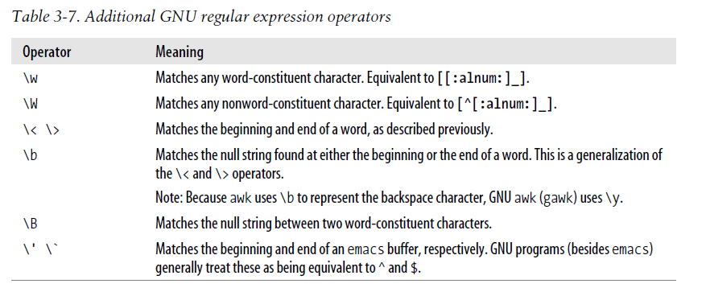
Extensions supported by GNU implementations
Usually use \ followed by a letter
Word matching
\<chop chop appears at beginning of word
chop\> chop appears at end of word

Slide 39
Specify pattern in files
-f option: useful for complicated patterns, also don’t need to worry about shell interpretation.
Example
$ cat alphvowels ^[^aeiou]*a[^aeiou]*e[^aeiou]*i[^aeiou]*o[^aeiou]*u[^aeiou]*$
$ egrep -f alphvowels /usr/share/dict/words abstemious ... tragedious

Slide 40
Outline
Shell globbing, or pathname expansion
grep, egrep, fgrep
Regular expression
Basics: BRE and ERE
Common features of BRE and ERE
BRE backreference
ERE extensions
sed: stream editor
cut, paste, comp, uniq, sort
40

Slide 41
Introduction to sed: substitution
Stream Editor: perform text substitution in batch mode
E.g., formatting data
E.g., batch modification, change variable names, function names in source code
Replace occurrence of a pattern in standard input with a given string, and display result in standard output
sed s/regular_expression/replace_string/
Substitute “command”: s
changes all occurrences of a regular expression into a new string
to change "day" in file old to "night" in "new" file:
sed s/day/night/ <old >new

Slide 42
Delimiter
sed s/regular_expression/replace_string/
One can use any letter to delimit different parts of command s
If delimiter appears in regular expr or replace str, escape them
To change /usr/local/bin to /common/bin:
sed 's/\/usr\/local\/bin/\/common\/bin/' <old >new
It is easier to read if you use other letter as a delimiter:
sed 's_/usr/local/bin_/common/bin_' <old >new
sed 's:/usr/local/bin:/common/bin:' <old >new
sed 's|/usr/local/bin|/common/bin|' <old >new

Slide 43
Introduction to sed: substitution
If you have meta-characters in the command, quotes are necessary
sed 's/3.1415[0-9]*/PI/' <old >new
To mark a matching pattern
grep -n count mylab1.cpp | sed s/count/<count>/

Slide 44
How sed works?
sed, like most Unix utilties, read a line at a time
By default, sed command applies to first occurrence of the pattern in a line
[zhang@storm ~]$ sed 's/aa*/bb/'
ab ab
bbb ab
To apply to every occurrence, use option g (global)
sed 's/aa*/bb/g
To apply to second occurence:
sed 's/aa*/bb/2

Slide 45
Aggressive matching
sed finds longest string in line that matches pattern, and substitute it with the replacing string
Pattern aa* matches with 1 or more a’s
[zhang@storm ~]$ sed 's/aa*/bb/'
aaab
bbb

Slide 46
Substitution with referencing
How to mark all numbers (integers or floating points) using angled brackets?
E.g., 28 replaced by <28>, 3.1415 replaced by <3.1415>
Use special character ‘&’, which refers to string that matches the pattern (similar to backreference in grep)
sed 's/[0-9][0-9]*\.[0-9]*/(&)/g'
You can have any number of ‘&’ in replacement string
You could also double a pattern, e.g. the first number of a line:
$echo "123 abc" | sed 's/[0-9]*/& &/'
123 123 abc

Slide 47
Multiple commands
To combine multiple commands, use -e before each command:
sed -e 's/a/A/' -e 's/b/B/' <old >new
If you have a large number of sed commands, you can put them into a file, say named as sedscript
# sed comment - This script changes lower case vowels to upper case
s/a/A/g
s/e/E/g
s/i/I/g
s/o/O/g
s/u/U/g
each command must be on a separate line
Invoke sed with a script:
sed -f sedscript <file.txt >file_cap.txt

Slide 48
sed interpreter script
Alternatively, starts script file (named CapVowel) with
#!/bin/sed -f s/a/A/g s/e/E/g s/i/I/g s/o/O/g s/u/U/g and make file executable
Then you can evoke it directly:
CapVowel <old >new

Slide 49
Restrict operations
Restrict commands to certain lines
Specifying a line by its number.
sed '3 s/[0-9][0-9]*//' <file >new
Specifying a range of lines by number.
sed '1,100 s/A/a/' All lines containing a pattern.
To delete first number on all lines that start with a "#," use:
sed '/^#/ s/[0-9][0-9]*//'
Many other ways to restrict

Slide 50
Command d
Command d: deletes every line that matches patten
To look at first 10 lines of a file, you can use:
sed '11,$ d' <file
i.e., delete from line 11 to end of file
If you want to chop off the header of a mail message, which is everything up to the first blank line, use:
sed '1,/^$/ d' <file

Slide 51
Command q
abort editing after some condition is reached.
Ex: another way to duplicate the head command is:
sed '11 q' which quits when eleventh line is reached.

Slide 52
Backreference
To keep first word of a line, and delete the rest of line, mark first word with the parenthesis:
sed 's/\([a-z]*\).*/\1/'
Recall: regular expr are greedy, and try to match as much as possible.
"[a-z]*" matches zero or more lower case letters, and tries to be as big as possible.
".*" matches zero or more characters after the first match. Since the first one grabs all of the lower case letters, the second matches anything else.
Ex:
$echo abcd123 | sed 's/\([a-z]*\).*/\1/'
abcd

Slide 53
Backreference (cont’d)
If you want to switch two words around, you can remember two patterns and change the order around:
sed 's/\([a-z][a-z]*\) \([a-z][a-z]*\)/\2 \1/’
To eliminate duplicated words:
sed 's/\([a-z]*\) \1/\1/'
If you want to detect duplicated words, you can use
sed -n '/\([a-z][a-z]*\) \1/p’
Up to nine backreference: 1 thru 9
To reverse first three characters on a line, you can use
sed 's/^\(.\)\(.\)\(.\)/\3\2\1/'

Slide 54
Sed commands & scripts
Each sed command consists of up to two addresses and an action, where the address can be a regular expression or line number.
A script is nothing more than a file of commands
address
action
command
address
action
address
action
address
action
address
action
script

Slide 55
sed: a conceptual overview
All editing commands in a sed script are applied in order to each input line.
If a command changes input, subsequent command address will be applied to current (modified) line in the pattern space, not original input line.
Original input file is unchanged (sed is a filter), and the results are sent to standard output (but can be redirected to a file).

Slide 56
Outline
Shell globbing, or pathname expansion
grep, egrep, fgrep
Regular expression
Basics: BRE and ERE
Common features of BRE and ERE
BRE backreference
ERE extensions
sed
cut, paste, comp, uniq, sort
56

Slide 57
Store Info in text file
Convention: one record per line, separate different fields using a delimiter (space, tab, or other characters)
Ex. /etc/passwd,
Each user’s record takes a line
Fields (Userid, numeric id, user name, home directory ) by ;
Output generated by ls, ps, …
Recall a design philosophy of Unix is use textual file, and providing a rich small filters working on such files …

Slide 58
Command cut
cut: displays selected columns or fields from each line of a file
Delimit-based cut
cutting one of several columns from a file (often a log file) :
cut -d ' ' -f 2-7
Retrieves second to seventh field assuming that each field is separated by a single space
Fields are numbered starting from one.
Character column cut
cut -c 4,5,20 foo # cuts foo at columns 4, 5, and 20.
How to choose file name and size from “ls –l” output?

Slide 59
Command paste
paste: merging two files together, line by line
E.g., Suppose population.txt stores world population info, GDP.txt stores GDP,
Population.txt GDP
Country population Country GDP
… …
paste f1 f2 > pop_GDP
Need to make sure info for same country are merged:
Sort files using country name first (if same set of countries are listed in both files, this solves problem)

Slide 60
Command join
join: for each pair of input lines with identical join fields, write a line to standard output.
join [OPTION]... FILE1 FILE2
-e EMPTY replace missing input fields with EMPTY
-i, --ignore-case ignore differences in case when comparing fields
-j FIELD equivalent to `-1 FIELD -2 FIELD‘
-1 FIELD join on this FIELD of file 1
-2 FIELD join on this FIELD of file 2

Slide 61
Command tr
tr - Translate, squeeze, and/or delete characters from standard input, writing to standard output.
cat file| tr [a-z] [A-Z] ## translate all capital letter to lower case
cat file | tr -sc A-Za-z '\n'
## replace all non-letter characters with newline
## -c: complement
## -s: squeeze

Slide 62
Command tr and uniq
uniq: report or omit repeated lines
-c: precede each unique line with the number of occurrences

Slide 63
wf (word frequency)
Ex: Get a letter frequency count on a set of files given on command line. (No file names means that std input is used.)
#!/bin/bash
cat $* |
tr -sc A-Za-z '\012' |
tr A-Z a-z|
sort |
uniq -c |
sort -nr -k 1
Uncomment the last two lines to get letters (and counts) from most frequent to last frequent, rather than alphabetical.
What is being generated at second command ?
* Command tee can be inserted into pipeline, to save the streams of input/
output into a file.

Slide 64
Command tee
tee – copy standard input to standard output and file
tee [OPTION]... [FILE]...
Option:
-a, --append
append to given FILEs, do not overwrite
Useful for insert into pipes for testing, and for storing intermediate results
ls -l | wc -l
To save output of ls -l
ls -l | tee lsoutput.txt | wc -l

Slide 65
Capture intermediate result in file
#!/bin/bash
cat $* |
tr -sc A-Za-z '\012' |
tr A-Z a-z|
sort | tee aftersort |
uniq -c |
sort -nr -k 1
For example: add the parts in red to store output of sort command to aftersort, and feed them to next command in the pipeline (uniq)…

Slide 66
Usage of tee
In shell script, sometimes you might need to process standard input for multiple times: count number of lines, search for some pattern:
#!/bin/bash
# usage: tee_ex pattern
echo Number of lines `wc –l`
echo Searching for $1
grep $1
Problems: standard input to the script (might be redirected from file/pipe) will be processed by wc (the first command in scripts that reads standard input). Subsequence command (grep here) does not get it ☹

Slide 67
tee to rescue
#!/bin/bash
# Usage: tee_ex pattern
echo Number of lines `tee tmp | wc –l`
echo Searching for $1
grep $1 tmp
rm tmp
Use tee to save a copy of standard input to file tmp, while at the same time copy standard input to standard output, i.e., fed into pipe to wc

Slide 68
Another solution
#!/bin/bash
# Usage: tee_ex pattern
# save standard input to file for later processing
cat > tmpfile
echo Number of lines `wc –l tmpfile`
echo Searching for $1
grep $1 tmpfile
rm tmpfile ## always clean up temporary file created …

Slide 69
Summary
Regular expression and Finite state automata
Single quote search patterns so that shell do not interpret characters that have special meaning to him:
*, ., $, ?, …
Be sure to distinguish regex and shell globbing
We look at grep regex, egrep regex
egrep regex is generally a superset of grep regex, except back reference
Some other useful filter commands

